Slide 1

Slide 1
CUSTOMER VALUE ANALYSIS REGRESSION PROCESS
RISHWANTH RAVINDRAN

Slide 2


Slide 10
Introduction To The Data
Auto Insurance Data gives insights about the customer lifetime value, CLV is the total revenue the client will derive from their entire relationship with a customer based on it we predict and draw some business recommendation

Slide 3

Slide 10
Data Description
Auto Car Insurance Data consists information such as Customer lifetime value, state, gender, policy type, vehicle type, vehicle size etc.

Slide 4
Slide 2
Objectives Of Data Driven
Analysis
Profitability of the firm is an important indicator of its financial stability as well as economic well being.
In a competitive market, only those firms survive which are able to make a profit. Hence, they always try to make it as large as possible. All other objectives are subjected to this primary objective.
Profit maximization objective is a time-honored objective of a firm and evidence against this objective is not conclusive or unambiguous.
Profit maximization objective has been found extremely accurate in predicting certain aspect of a firm’s behavior and trends; as such the behavior of most firms are directed towards the objective of profit maximization.

Slide 5
Slide 3
Dependent Variable
Customer Lifetime Value - CLV is the total revenue the client will derive from their entire relationship with a customer

Slide 6
Slide 3
Count Of Variables And Observations
Customer Value Analysis Data
Customer Value Analysis Data consists of 9134 rows and 22 columns

Slide 7
Slide 3
Significant Variables
Name of the variables
Monthly Premium Auto
Total Claim Amount
Coverage
Education
Employment Status
Marital Status
Type of Policies
Renew Offer Type
Vehicle Class
Vehicle Size

Slide 8
Slide 3
Insignificant Variables
Name of the variables
Customer
Response
Gender
Location Code
Policy Type
Policy
Sales Channel

Slide 9
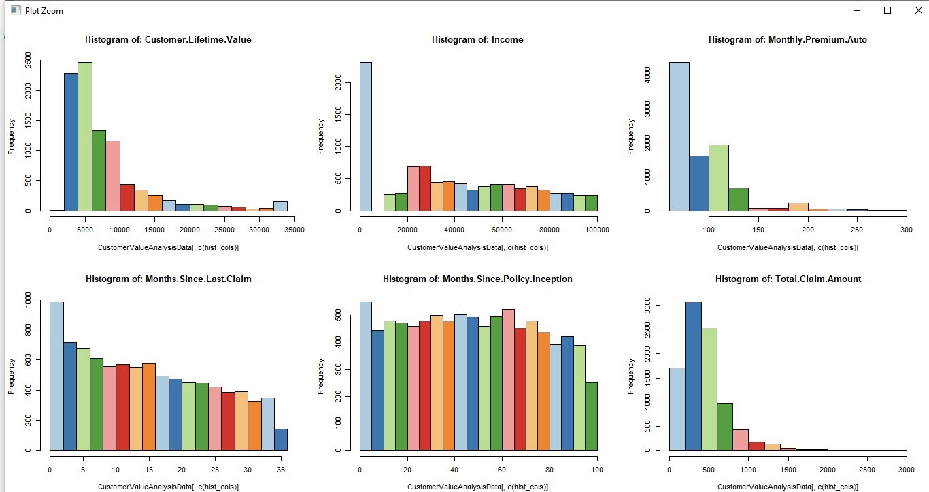
Slide 3
Graphical Display Of Variables
Exploring Multiple Continuous Variable

Slide 10
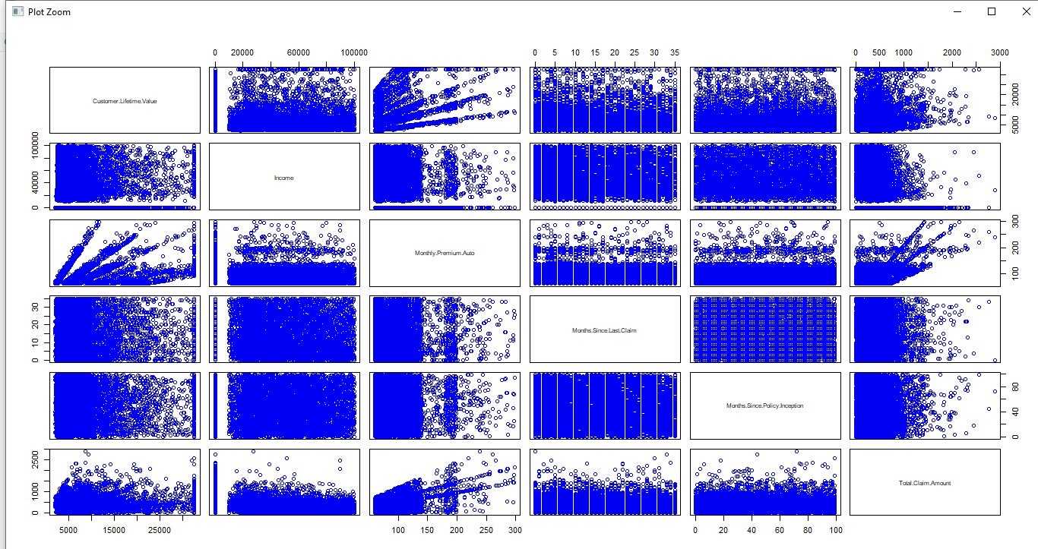
Slide 3
Graphical Display Of Variables
Bivariate Analysis
Continuous Vs Continuous- Scatter Plot

Slide 11
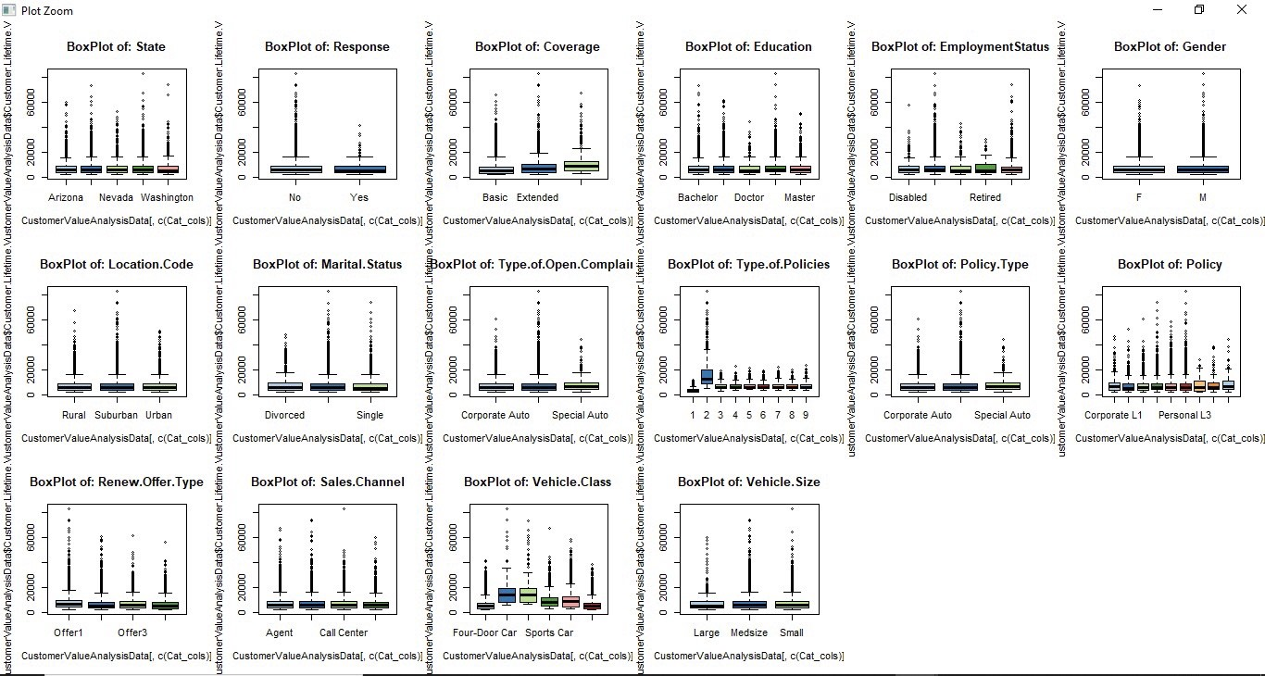
Slide 3
Graphical Display Of Variables
Bivariate Analysis
Continuous Vs Categorical - Box Plot

Slide 12
Slide 3
Results Obtained
Key and mandatory mentions for this R-Project:
R-square and adjusted-R-square values
Multiple R-squared: 0.6901, Adjusted R-squared: 0.6896
Multiple R-squared is higher than Adjusted R-squared and thus showing the model is having good fit
Test for homoskedasticity
Null Hypothesis
HO: there exists homoskedasticity: error variances are equal
p-value < 0.00000000000000022
Null Hypothesis is rejected
Test for serial correlation
Autocorrelation occurs when the residuals are not independent from each other
Null Hypothesis
HO: No autocorrelation
p- value > 0.05 means HO is accepted
p-value = 0.6269
Null Hypothesis is accepted

Slide 13
Slide 3
Results Obtained
Key and mandatory mentions for this R-Project:
Test for normality
Null Hypothesis
HO: errors are normally distributed
p-value < 0.00000000000000022
Null Hypothesis is rejected
Comparison of models
Linear Regression
Mean Accuracy of Linear Regression Model is: 79.0169856461506
Median Accuracy of Linear Regression Model is: 86.9119136041219
Decision Tree
Mean Accuracy of Decision tree Model is: 88.3197276515216
Median Accuracy of Decision tree Model is: 97.7292847875328
Based on accuracy Decision Tree is showing high accuracy

Slide 14
Slide 3
Variable Relationships
All the variables taken as significant shows positive coefficients
Monthly Premium Auto 66.902
I(Employment Status == "Employed") 598.930
Type.of.Policies2 11656.118
Type.of.Policies3 3574.899
Type.of.Policies4 3543.860
Type.of.Policies5 3560.924
Type.of.Policies6 3567.960
Type.of.Policies7 3609.768
Type.of.Policies8 3580.984
Type.of.Policies9 3572.305
I(Vehicle Class == "Sports Car") 935.012
I(Vehicle Class == "SUV") 547.782

Slide 15
Slide 5
Business Recommendations
Convert One-Time Clients Into Recurring Clients
Have offers with recurring billing
Keep in touch with customers
Drop Low Performers
Remove or Delegate Non-Essential Tasks

Slide 16
Slide 5
Business Recommendations
Encourage Referrals
A referral program with discounts and perks in exchange for referrals
Create a customer experience that demands to be shared
Encourage public reviews and testimonials from satisfied customers

Slide 17
Slide 5
Business Recommendations
Eliminate Bottlenecks in Your Sales Funnel
In which part of the sales process do most potential customers drop off?
Is there a way to simplify your funnel?

Slide 18
Slide 6
CONCLUSION
With these strategies we can strengthen the relationship with the customers and maximize the revenue

Slide 19
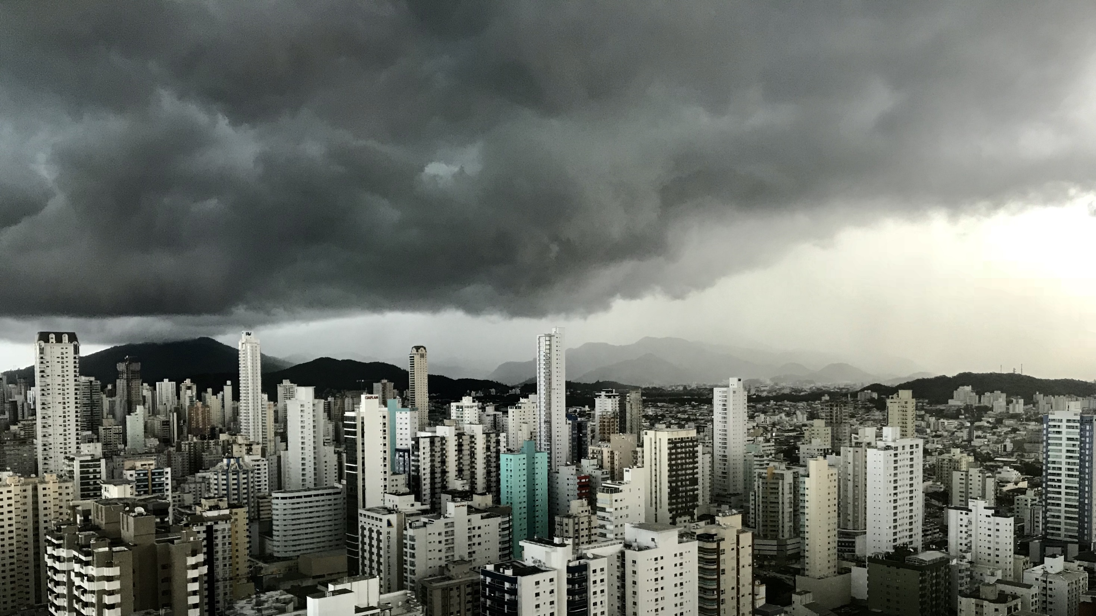
Slide 11
THANK YOU

